Slide 1
Game Design Presentation
Second Draft - Gameplay, NPCs and Character Classes

Slide 2
INTRODUCTION

Slide 3
Game Description
Two factions, fighting over control points and achieving small goals on side.
Genre: Top-down Action Role Playing Game
Theme: Fantasy/Medieval
Style: Cartoony
Game Sequence: Tutorial Quests

Slide 4
Game Features
Massive Multiplayer Online Game
Faction vs. Faction Combat
Control Points
Points of interest that yield advantages
Players can use the control points to respawn after death
Protected by neutral NPCs who fight with whichever team is controlling the zone

Slide 5
Game Features Cont’d
Tutorial Quest: gets the player involved
Introduces main mechanics of the game
Helps the character get used to gameplay mechanics
Shows the ropes, introduces the control points, the golem pieces, basic controls, etc...
Presented to the character as splash screens

Slide 6
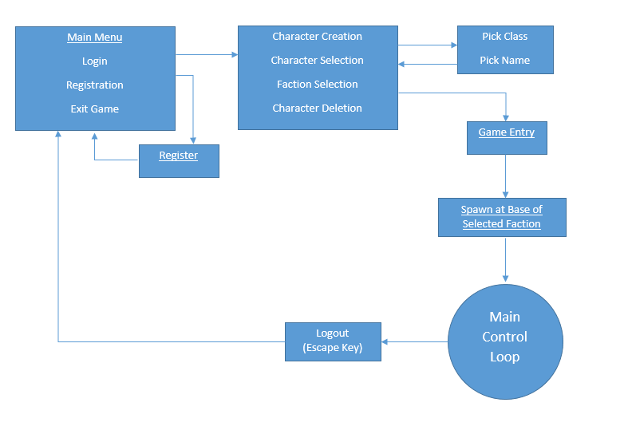
Flow Chart

Slide 7
Character Classes
Main Character Design
Finite Hit Point Pool
Normal basic attack with no cooldown
Stronger special attack with a cooldown
Movement Speed

Slide 8
Character Classes: The Sword
The Sword
Faster and evasive
Single target fast sword swing attack
Gap closer frontal charge that damages if contact is made with a hostile character
Hit points: 100

Slide 9
Sword Attacks
Sword Jab:
damage 15
No cooldown
single target
Bull Rush:
damage 30
5 second cooldown
single target

Slide 10
Character Classes: The Axe
The Axe
Slower and more powerful
Multi-target frontal slow axe swing attack
Stronger but slower single target
Hit Points: 120

Slide 11
AXE Attacks
Cleave:
Damage 12
No cooldown
Multi target
Skullsplitter
Damage 40
5 Second cooldown
Single target and 1 second cast time

Slide 12
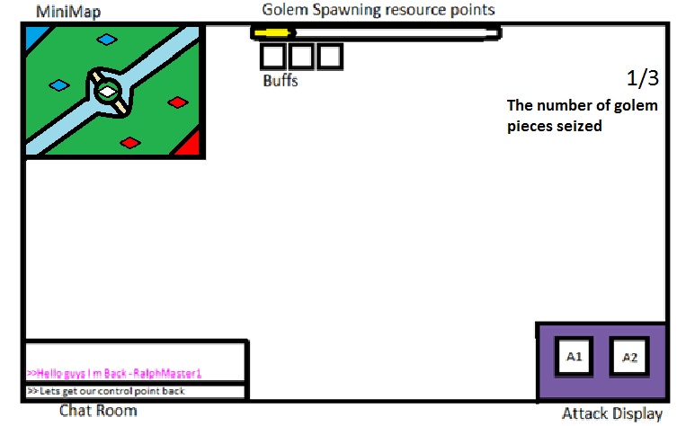
User Interface

Slide 13
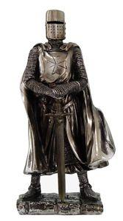
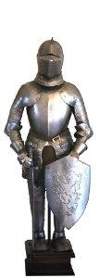

Control Points

Slide 14
Control Points Cont’d
Specific areas of the map designed to provide advantage
Provides different advantages:
Faction Wide Buff
Resources points over-time which can be used to spawn golem pieces
Area Control and Respawn Points

Slide 15
Control Points Cont’d
Teams are awarded resource points depending on how many control points they possess
Each control point has a different amount of resource generation
When certain resource milestones are reached, the team can spawn their golem piece

Slide 16
Control Points Cont’d
3 types of control points
Attack (on each side)
Defence(on each side)
Money(in the center of the map)
Notes:
Attack
Provides 5 resource points / 10 seconds & Provides a faction wide buff of +10% more damage to friendly players
Defense
Provides 5 resource points / 10 seconds & Provides a faction wide buff of +10% more hit points to friendly players
Money
Provides 10 resource points every 10 seconds & This control point is mainly for resources to build a golem

Slide 17
Control Points Cont’d
Attack
Provides +10% damage to the controlling faction
Provides 5 resource points every 5 seconds
Defense
Provides +10% hit points to the controlling faction
Provides 5 resource points every 5 seconds
Money
Provides +10 resource points every 5 seconds

Slide 18
Control Points Cont’d
Controlling two of any particular control point will provide a +25% buff instead of +20% buff to the controlling faction
Incentive for controlling the same control points

Slide 19
Control Points Cont’d
Taking a control point
Dispose of enemy players
Dispose of enemy guards
Remain in the control area for 30 sec
Contesting a control point
Character must be within the control area to contest

Slide 20
Control Points Cont’d
Control Points provide healing to friendly players
+10 hit points per 5 seconds
Allows damaged players the ability to heal
Incentive for capturing control points
This healing is suspended whenever the control point is being contested

Slide 21
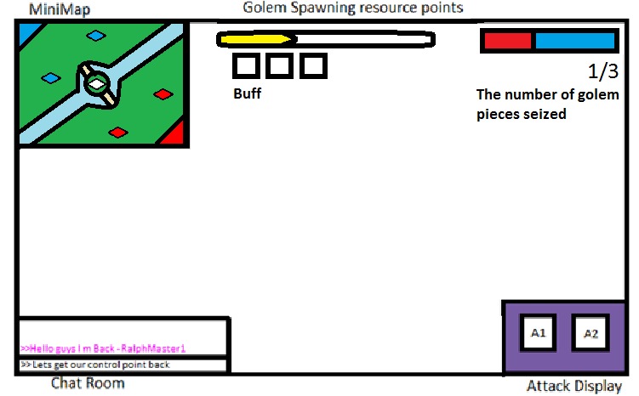
User Interface Cont’d

Slide 22
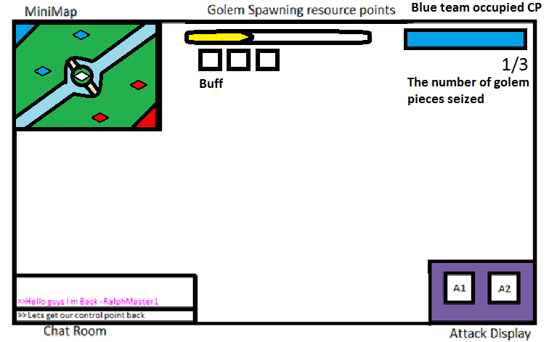
User Interface Cont’d

Slide 23
Guards
Five friendly NPC guards spawn after taking a control point
Defend control points
Stay within control point radius
Melee Range
Hit points : 200
Normal Melee Attack - 8 damage

Slide 24
Guards Cont’d
The Golem piece spawns with five neutral NPC guards
These guards attack players from either faction
Twice as strong as standard control point guards
Remain within golem piece area

Slide 25
The Golem
Friendly “Boss” NPC
High health, high damage
Slow movement speed
AOE attack
Always attacks the closest enemy-held control point
Keeps going until death

Slide 26
Golem Attacks
Hit Points: 2500
Normal Auto Attack:
Damage 40
0 second cooldown
Multi targets
Ground Pound:
Damage 75
3 second cast time and 20 second cooldown
Multi targets

Slide 27
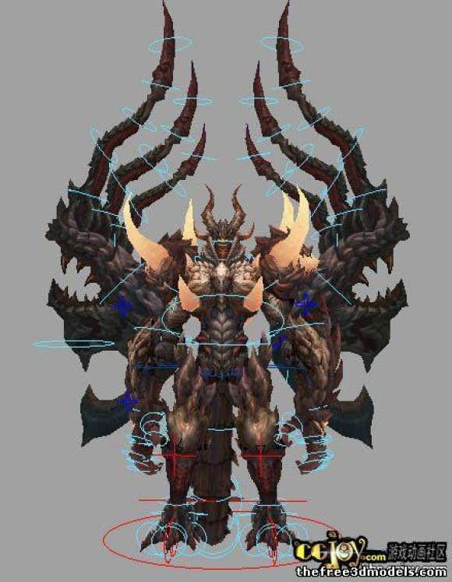

Slide 28
Golem Pieces
When a certain resource point milestone is reached, one of three golem pieces spawns on a random area of the map
The general vicinity of the area is highlighted on the map and a timer appears till the piece spawns
Both teams can see the timer and the highlighted area

Slide 29
Golem Pieces
Spawns a Neutral control point
Guarded by high-level NPC Guards
A faction must hold the point for 45 seconds to capture the piece
If the team that spawned the golem piece captures it, the piece is awarded to their faction
If the enemy team captures it, the piece is destroyed

Slide 30
Golem Pieces
If any enemy player enters the control point radius, the timer pauses
If the enemy team retakes the control point, the timer is reset and starts counting up for the enemy team
Similar to taking control points

Slide 31
Level Design
Level design is going to be challenging to keep the game interesting
Can support multiple maps or just the single one
Basic Map Design
Mostly symmetrical sides

Slide 32
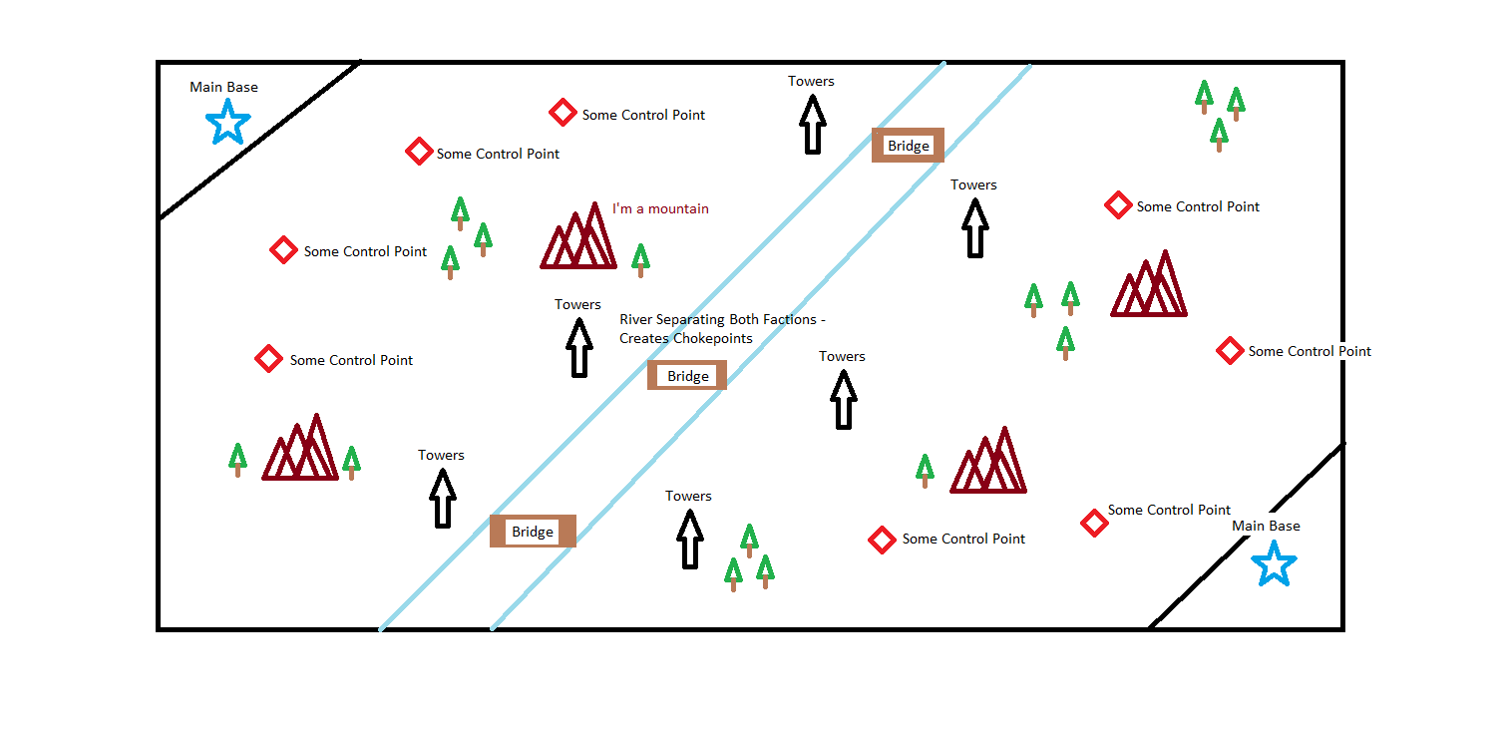
(Basic) Level Design

Slide 33
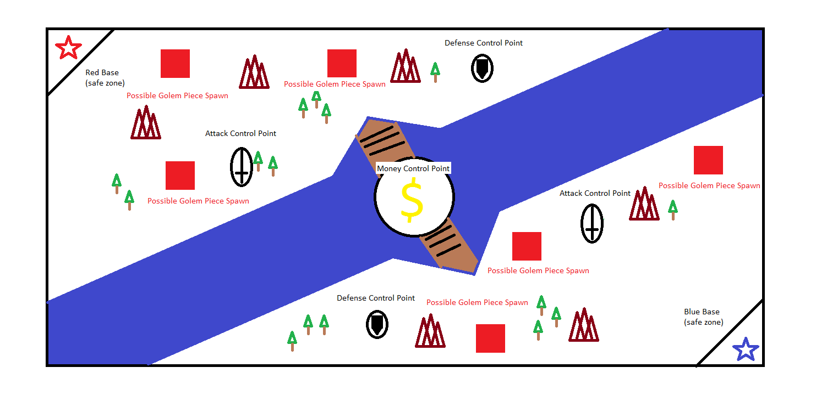

Slide 34
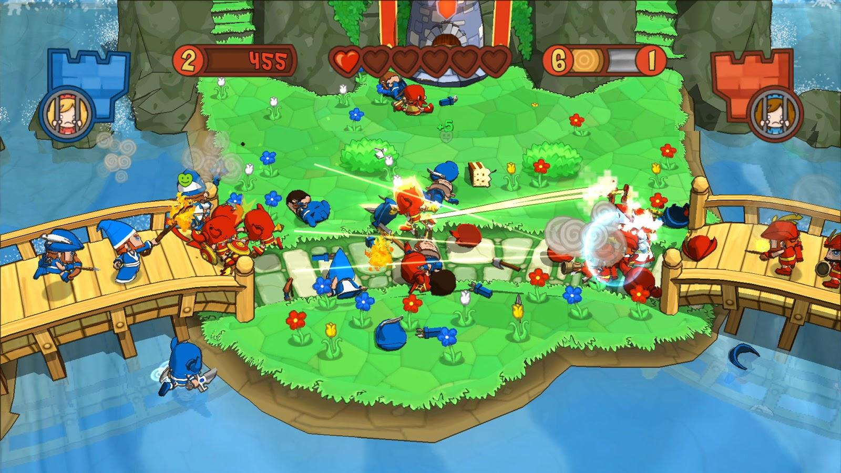

Slide 35

Game Name/Logo

